Slide 1
Algorithm Efficiency and Big-O Notation
Programming – Code Design and Data Structures

Slide 2
Overview
Big O Notation, a method for calculating how fast an algorithm will execute based on ‘n’. In the worst case scenario.
Big O Notation
O(1)
O(n)
O(n²)
O(2^{n})
O(log n)

Slide 3
Algorithm Efficiency
In most cases, there are many ways to accomplish the same task
For example, sorting data, path finding, NPC behaviours
Different ways data could be stored
It is often important to be able to estimate how long a particular algorithm will take, given a set of data
Some algorithms will work better than others in a given situation, but perform worse in others in the next

Slide 4
Big O Notation
Big O Notation is a system for explaining the worst case execution times of an Algorithm
O means “order”, as in mathematics, and the system describes how the run time increases in relation to the number of items affecting the algorithm
Notes:
Order as in order of magnitude

Slide 5
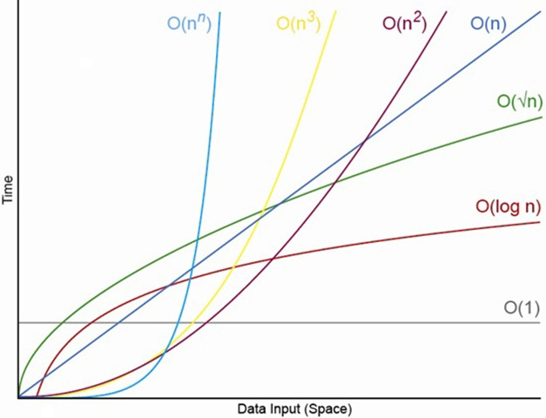
Big O Notation
O(1) Constant
O(n) Linear
O(n²) Quadratic
O(2^{n}) Exponential
O(log n) Logarithmic

Slide 6
Constant – O(1)
This operation performs in constant time
The operation always takes the same amount of time to run, and is unaffected by the number of items it must operate on
bool IsFirstElementZero(int items[], int nItems)
{
if (items[0] == 0)
return true;
return false;
}

Slide 7
Linear - O(n)
This algorithm performs in linear time
If n doubles, the time doubles
A search through an unordered array is an example of linear time
bool ContainsValue(int items[], int nItems, int searchValue)
{
for(int i=0; i < nItems; ++i)
{
if(items[i] == searchValue)
return true;
}
return false;
}

Slide 8
Quadratic O(n²)
Quadratic order is far worse than linear, it’s proportional to the square of the size of the dataset
Consider the problem of testing if an unsorted array has an entry that appears twice; The following is a simple brute-force implementation
bool ContainsDuplicate(int items[], int nItems)
{
for (int i = 0; i < nItems; i++)
{
for (int j = 0; j < nItems; j++)
{
if (items[i] == items[j])
return true;
}
}
return false;
}

Slide 9
Exponential O(2^{n})
Execution time doubles for each additional input into the dataset.
Time will increase very sharply (worse than quadratic) as the dataset grows!
In this example, the fibonacci method is called twice within its self. Until 0 or 1 is passed in.
#include <iostream>
int fibonacci(int n)
{
if (n == 0) return 0;
else if (n == 1)return 1;
else return fibonacci(n - 1) + fibonacci(n - 2);
}
int main(int argc, char **argv)
{
for (int i = 0; i < 10; i++)
{
// each execution of the fibonacci method
// will take longer than the last time,
// as i increases, so does the execution time.
std::cout << fibonacci(i) << std::endl;
}
return 0;
}

Slide 10
Logarithmic - O(log n)
Its relative performance actually improves as n increases
In other words, the execution time is linear O(n) for small sets, and tends towards O(1) for large sets
A binary search is a great example of this
The algorithm continues to divide the dataset until either the search value is found, or the end of the set has been reached
The time cost of each new item is smaller than the one before it

Slide 11
Related Notations
There are two other notations that are also used to describe algorithm complexity:
Big Omega notation describes best case
Ω(n) describes an algorithm that never performs better than linear.
Big Theta notation describes a combination of best and worst
Θ(n) is an algorithm that is never better or worse than linear.
Often said to be the average time taken.

Slide 12
Summary
When using a existing algorithm, research its Big O “score”, and work out whether it is the right one to use
The running time of a algorithm is based on both the number of items, but also how those items are stored
Getting the smallest item in a sorted list is constant – Just return the first one!
Getting the smallest item in a non sorted list is linear time – Look at all items.

Slide 13
References
Sherrod, A, 2007, Data Structures and Algorithms for Game Developers, 1st Edition, Charles River Media
Cormen, T, et al, 2009, Introduction to Algorithms, 3rd Edition, MIT Press

